Slide 1

TEMPRETURE AND HUMIDITY MESAUREMENT WITH LCD DISPLAY
Semester II (2021-2022)
Embedded Systems Course
Final Project Presentation
Course Code: CPE316
Supervisors: Dr. Iman Elawady ; ENG. Michael B.Khani
Team [TEAMNAME] members:
Burak, Borhan, 1810213077 * borhanburak@hotmail.com | Yunus, Korkmaz, 1810213036 yunud.korkmaz.9843@gmail.com
Mert, Gül, 1810213027 9emertgul@gmail.com | Mustafa, Kozan, 1810213038 mkozan273@gmail.com
Rıfat Tayyip, Ulusoy, 1810213061 rfatulusoy314@Outlook.com | Aslı, Şahin, 1810213030 aslısahin464@gmail.com
Burak Borhan, 1810213077

Slide 2

Contents
Introduction
Objectives
Conclusion
Project Design
References
Related Works
Application
Software
Hardware
Challenges
Results
Future works
Why we need it
Our goal

Slide 3
Introduction

Slide 4
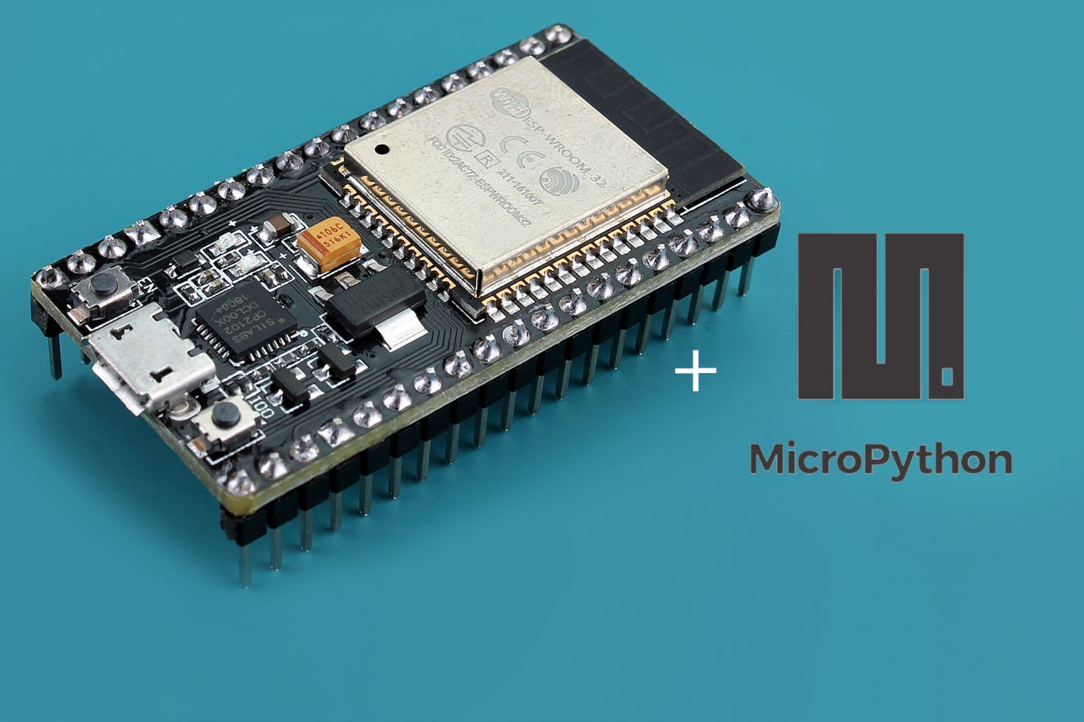
Introduction
Humidity and temperature have always been a problem for waterside areas, especially for people working in industry. Our project, on the other hand, acts as a precaution for people to take precautions against these problems.

Slide 5
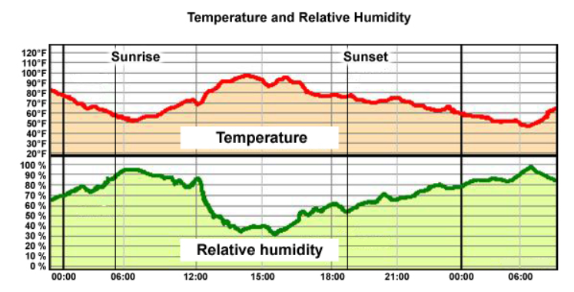
Introduction

Slide 6
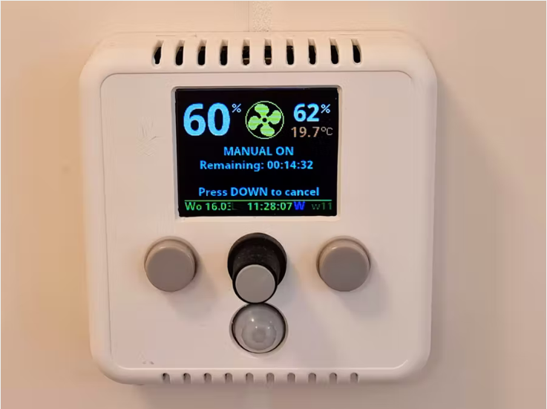
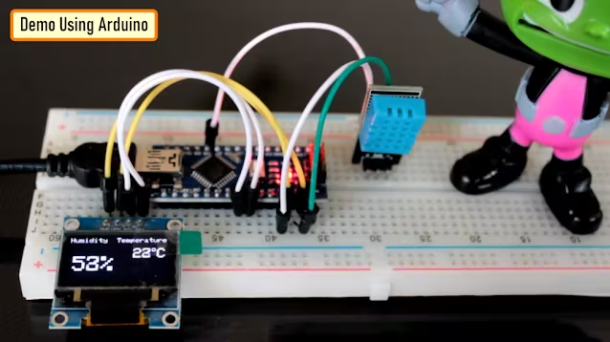
Related Works
Bathroom ventilation fan controller V2.2.1
Weather Station Using Arduino

Slide 7
Related Works
Weather Station Using Arduino:
As in our project, it is a device that measures the humidity and temperature in the environment. It is expected to assist forecasts at weather stations.
Unlike our project, the DHT11 sensor is used here.

Slide 8
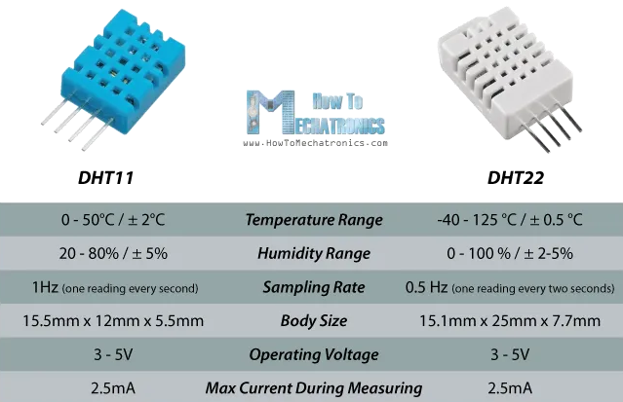

Slide 9
Bathroom ventilation fan controller V2.2.1:
It is a project that has been created in order to suppress the effect of hot water on the temperature and humidity in the environment while the user takes a bath.
Features:
Graph display of the past 24h humidity and temperature.
Weather info and forecast on the display

Slide 10
Project Design

Slide 11

Project Design
Our device powered by DHT22 sensor and ESP32 chip measures the humidity and temperature in the air and reflects the data to the user with the LCD screen.
Since Python is a more understandable and useful language for embedded systems, the microPyhton language is included in this project.
Temperature and humidity can cause deterioration in the health status of those working in areas close to water, and also have a great impact on the efficiency of their work.

Slide 12
Project Design
In rainy and snowy weather, it is a big problem that the circuits are short-circuited and the system stops working as a result of water contact.
Our sensor is slow compared to other sensors due to its structure.
If the frequency value in the code text of our device is incorrectly specified, an incorrect result may be encountered.

Slide 13
Conclusion

Slide 14
Conclusion
We tried to send a notification to the user about the humidity and temperature values, but since the simulator did not allow this, we decided to reflect it on the LCD screen.
We would like to find a way to inform the remote user about the status of the environment instead of just projecting it on the LCD screen and add it to our project.

Slide 15
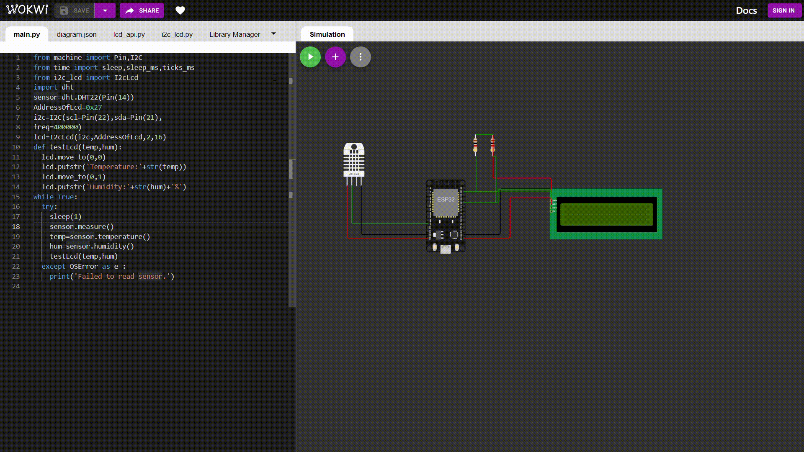

Slide 16
References
https://cb-electronics.com/why-dht22-is-better-than-dht11/
https://create.arduino.cc/projecthub/tarantula3/weather-station-using-arduino-and-nodemcu-d2b9d3?ref=tag&ref_id=humidity&offset=34
https://create.arduino.cc/projecthub/edr1924/bathroom-ventilation-fan-controller-v2-1-ba99bc?ref=tag&ref_id=humidity&offset=9
https://fm.okstate.edu/energyservices/energymanagement/blog/temp-humidity.html

Slide 17
THANKS FOR LISTENING

